Slide 1


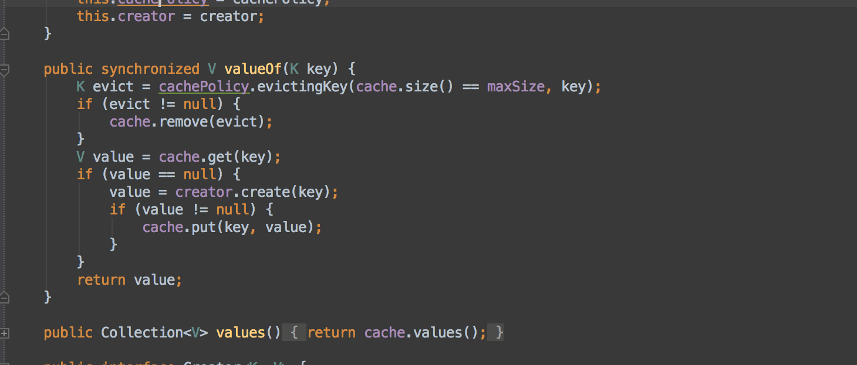

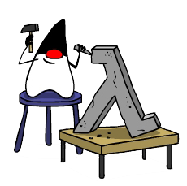
Functional Programming
Lambda Expressions
Advanced
Java
SoftUni Team
Technical Trainers
Software University
http://softuni.bg

Slide 2

Table of Contents
Functional Programming Paradigms
Lambda Expressions
Consumer<T>, Supplier<T>
Predicate<T>, Function<T,R>
Passing Functions to Methods
λ

Slide 3
Questions
sli.do #7923

Slide 4
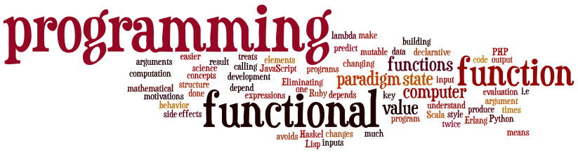
Functional Programming
Paradigms, Concepts
Notes:
Functional programming is a programming paradigm
Uses computations of mathematical functions to build programs
Declarative programming paradigm (not imperative)
Pure-functional languages (no variables and loops): Haskell
Almost-functional: Clojure, Lisp, Scheme, Scala, F#, JavaScript
Imperative with functional support: C#, Python, Ruby, PHP, Java
Non-functional: C, Pascal, the old versions of C#, Java, C++, PHP

Slide 5
Functional Programming
Functional Programming is a programming paradigm
Treats computation as evaluation of mathematical functions
Declarative programming paradigm
Contrasts the Imperative programming paradigm
All data is immutable
The program is stateless

Slide 6
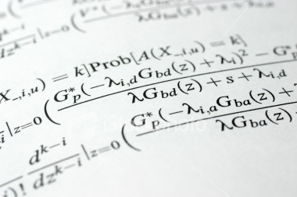
Lambda Expressions

Slide 7
Lambda Expressions
A lambda expression is an anonymous function containing expressions and statements
Used to create delegates or expression tree types
Lambda expressions
Use the lambda operator ->
Read as "goes to"
The left side specifies the input parameters
The right side holds the expression or statement

Slide 8

Lambda Expressions
Examples

Slide 9
Consumer<T>
In Java Consumer<T> is a void method:
Instead of writing the method we can do:
Then we use it like that:
void print(String message) {
System.out.println(message);
}
Consumer<String> print = message -> System.out.print(message);
print.accept("pesho");
print.accept(String.valueOf(5));

Slide 10
Supplier<T>
In Java Supplier<T> takes no parameters:
Instead of writing the method we can do:
Then we use it like that:
void generateRandomInt() {
Random rnd = new Random();
return rnd.nextInt(51);
}
Supplier<Integer> generateRandomInt = () -> new Random().nextInt(51);
int rnd = generateRandomInt.get();

Slide 11
Consumer<T>
Exercises in class

Slide 12
Predicate<T>
In Java Predicate<T> evaluates a condition:
Instead of writing the method we can do:
Then we use it like that:
boolean isEven(int number) {
return number % 2 == 0;
}
Predicate<Integer> isEven = number -> number % 2 == 0;
System.out.println(isEven.test(6)); //true

Slide 13
Function<T,R>
In Java Function<T,R> is a method that accepts a parameter of type T and returns type R
We can use Function<T,R>
int increment(int number) {
return number + 1;
}
Function<Integer, Integer> increment = number -> number + 1;
int a = increment.apply(5);
int b = increment.apply(a);

Slide 14
Predicate<T> and Function<T,R>
Exercises in class

Slide 15
Passing Functions to Method
We can pass Function<T,R> to methods:
We can use the method like that:
int operation(int number, Function<Integer, Integer> function) {
return function.apply(number);
}
int a = 5;
int b = operation(a, number -> number * 5);
int c = operation(a, number -> number - 3);
int d = operation(b, number -> number % 2);

Slide 16
Passing Functions to Method
Exercises in class

Slide 17
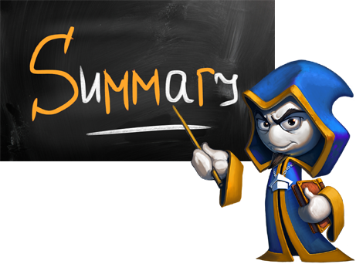
Summary
Lambda expressions are anonymous functions used with delegates
Consumer<T> is a void function
Supplier<T> gets no parameters
Predicate<T> evaluates a condition
Function<T,T> is a function that returns R type

Slide 18








Functional Programming
https://softuni.bg/courses/java-advanced

Slide 19

License
This course (slides, examples, demos, videos, homework, etc.) is licensed under the "Creative Commons Attribution-NonCommercial-ShareAlike 4.0 International" license
Attribution: this work may contain portions from
"Fundamentals of Computer Programming with Java" book by Svetlin Nakov & Co. under CC-BY-SA license
"OOP" course by Telerik Academy under CC-BY-NC-SA license

Slide 20






Free Trainings @ Software University
Software University Foundation – softuni.org
Software University – High-Quality Education, Profession and Job for Software Developers
softuni.bg
Software University @ Facebook
facebook.com/SoftwareUniversity
Software University @ YouTube
youtube.com/SoftwareUniversity
Software University Forums – forum.softuni.bg

